Slide 1



Immigration Matters 移民问题/事务
1. Pre-Arrival to Thailand 到达泰国之前
2. On Arrival in Thailand
到达泰国时
3. During Study Period
在学习期间
4. Leaving Thailand
离开泰国时
5. General Dos
一般需要做的事情
6. Important DONTs
非常重要的不能做的事

Slide 2


Pre-Arrival 到达前
Apply for a Non-Immigrant ED Visa before travelling to Thailand
在来泰国之前申请学习签证
Apply for a visa through www.thaievisa.go.th.
通过网页www.thaievisa.go.th.申请签证

Slide 3
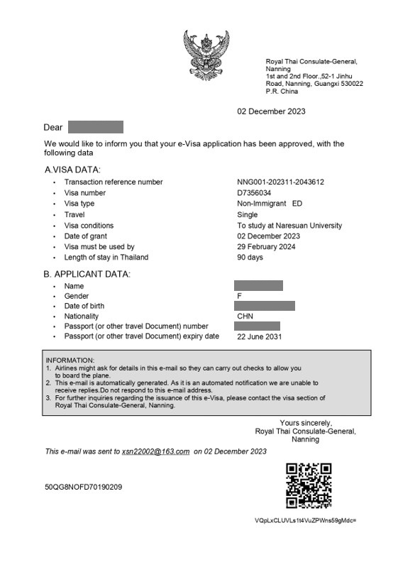
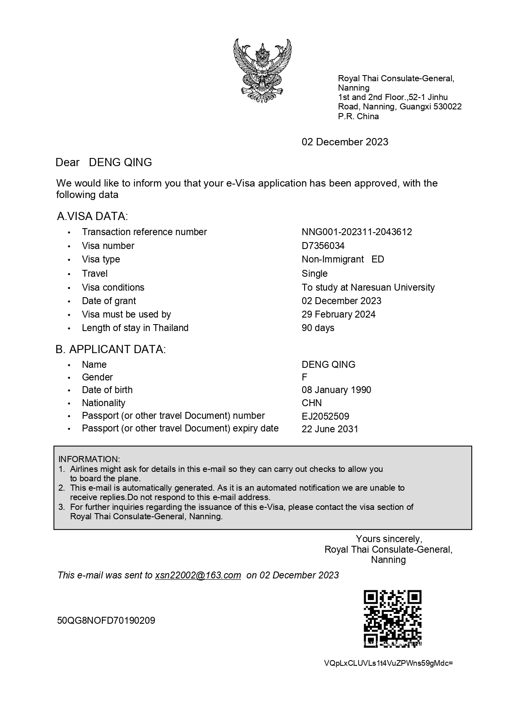
Pre-Arrival 到达前
Apply for a Non-Immigrant ED Visa before travelling to Thailand
在来泰国之前申请学习签证
2. Check your visa validity and entry conditions.
检查你的护照有效期和准入条件

Slide 4


On Arrival in Thailand 到达泰国
Immigration Process at the Airport 在机场的移民过程
Receive a Thailand Digital Arrival Card: Keep it in your passport at all times.
收到泰国数字入境卡：时刻把它放在你的护照里

Slide 5
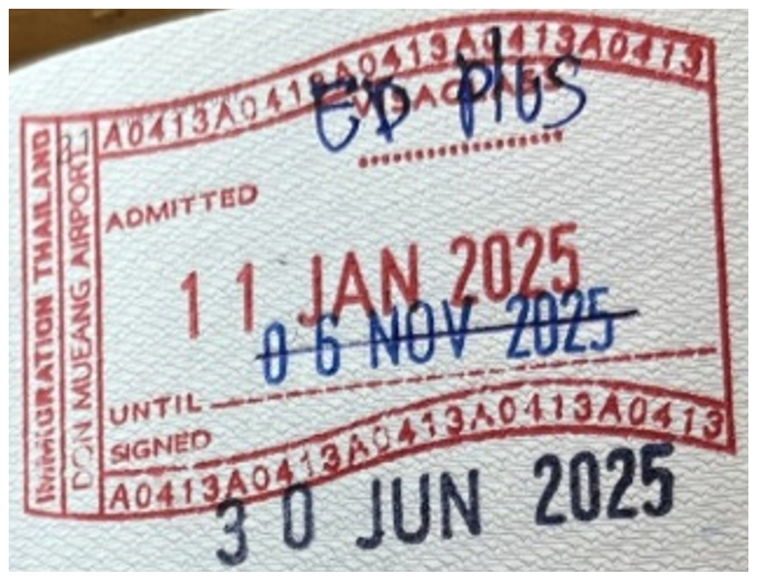
On Arrival in Thailand 到达泰国时
Immigration Process at the Airport 在机场的移民过程
2. Check your Entry Stamp: Ensure the date and visa type are correct.
检查你的入境印章：确保时间和签证的类型是正确的
Visa Type 签证类型
ED Plus
Arrival Date 到达时间
11 JAN 2025
Visa Expiration Date 签证到期时间
30 JUN 2025

Slide 6
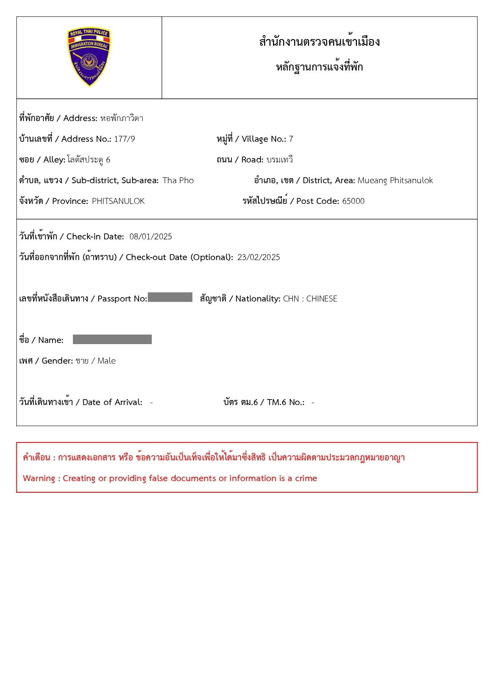
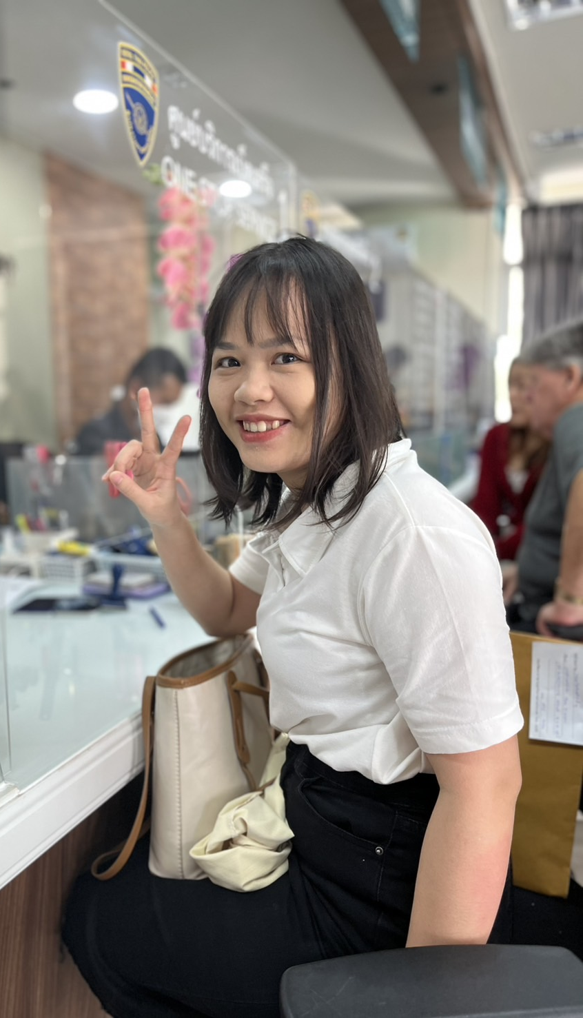
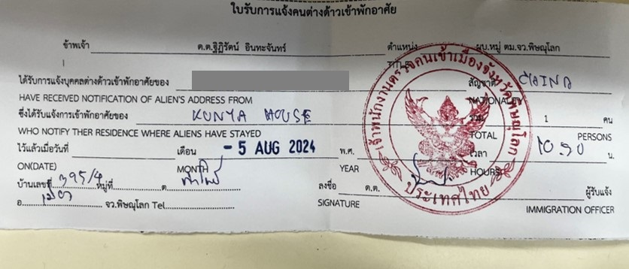
During Study Period – Your Responsibilities在学习期间-你的责任 Immigration Requirements While Studying在学习期间移民的要求
1. Address Registration: 住址登记
Register your address every time you enter or exit Thailand. 登记你的住址每次你入境或是出境.
You can do it online or at Phitsanulok Immigration Office. 你可以在网上进行报备或者去彭世洛移民局办理.
← Failure may result in fines of 2,000 Baht,
up to a maximum of 10,000 Baht 报备失败可能会被罚款2000泰铢，最高可达10000泰铢
Example 1 例子1
Example 2 例子2

Slide 7
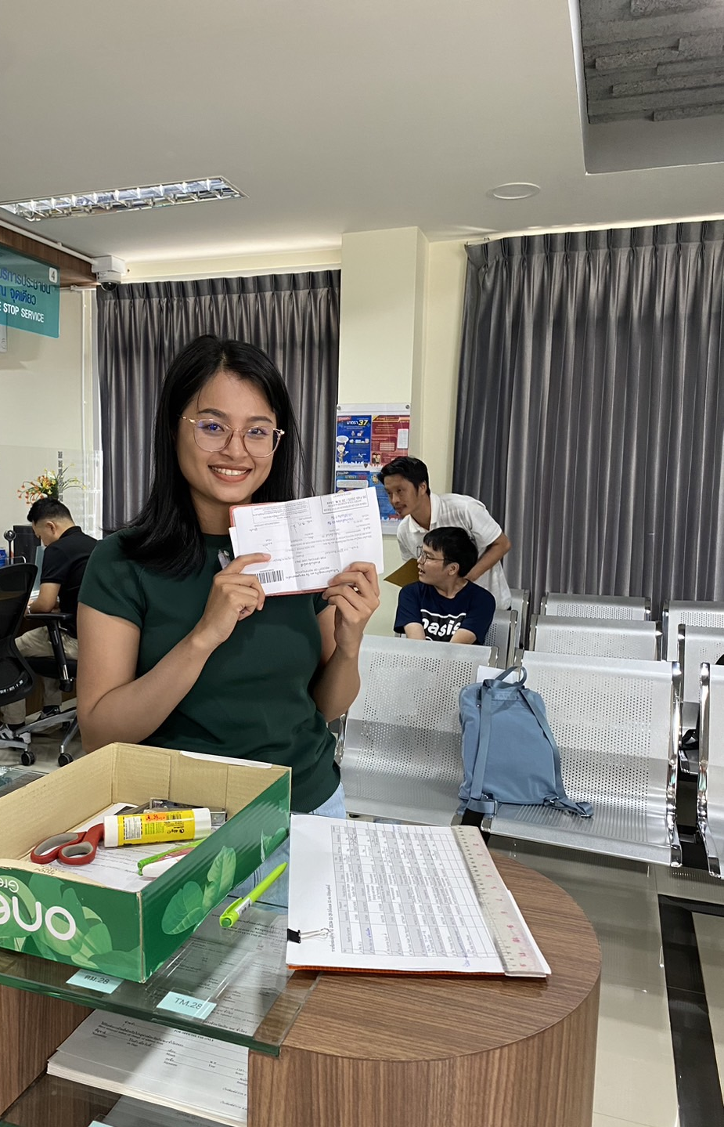
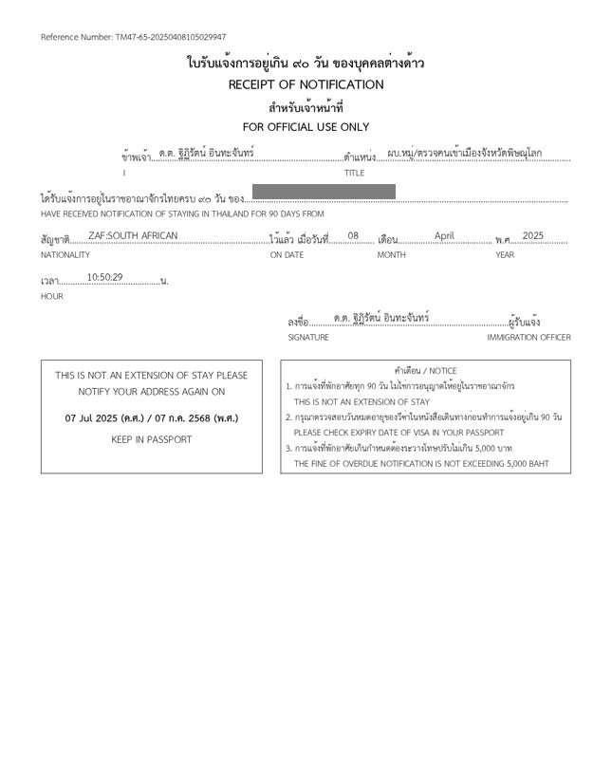
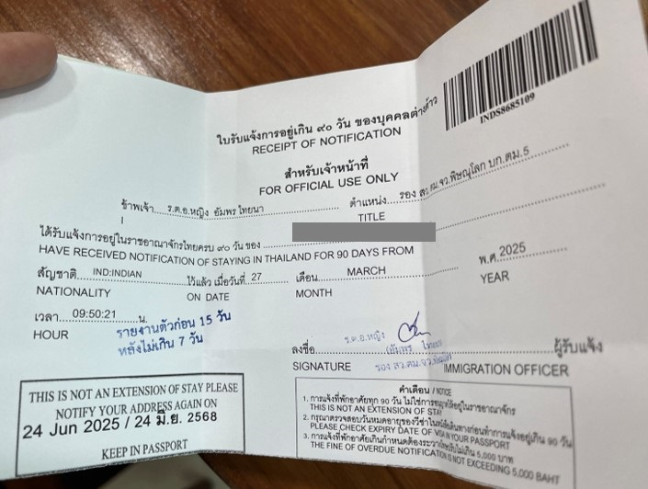
During Study Period – Your Responsibilities 在学习期间-你的责任 Immigration Requirements While Studying 在学习期间的移民要求
2. 90-Day Reporting: 90天报备
Report every 90 days (online or in-person).
每九十天报备（在网上或者亲自去报备）
← Failure may result in fines of 2,000 Baht, up to a maximum of 5,000 Baht.报备失败可能会被罚款2000泰铢，最高可达5000泰铢.
Example 1 例子1
Example 2 例子2

Slide 8
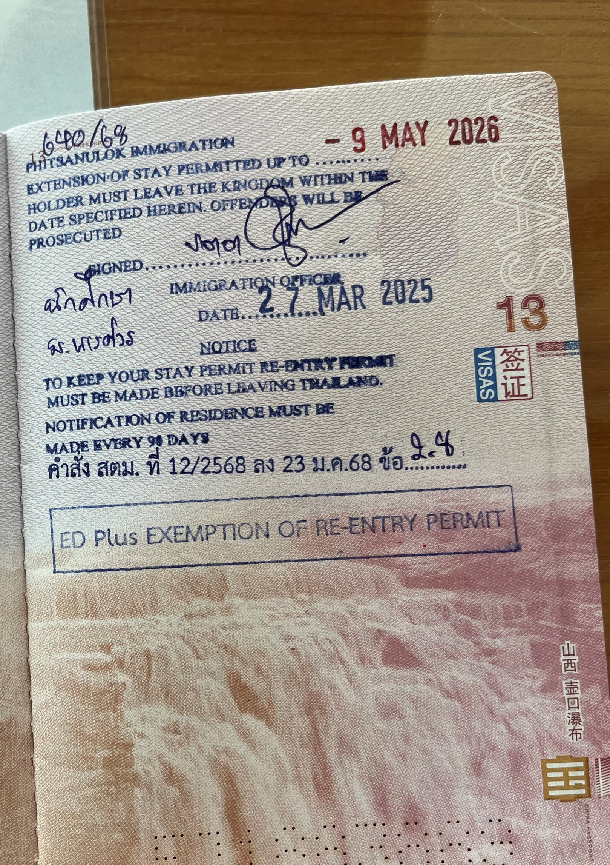
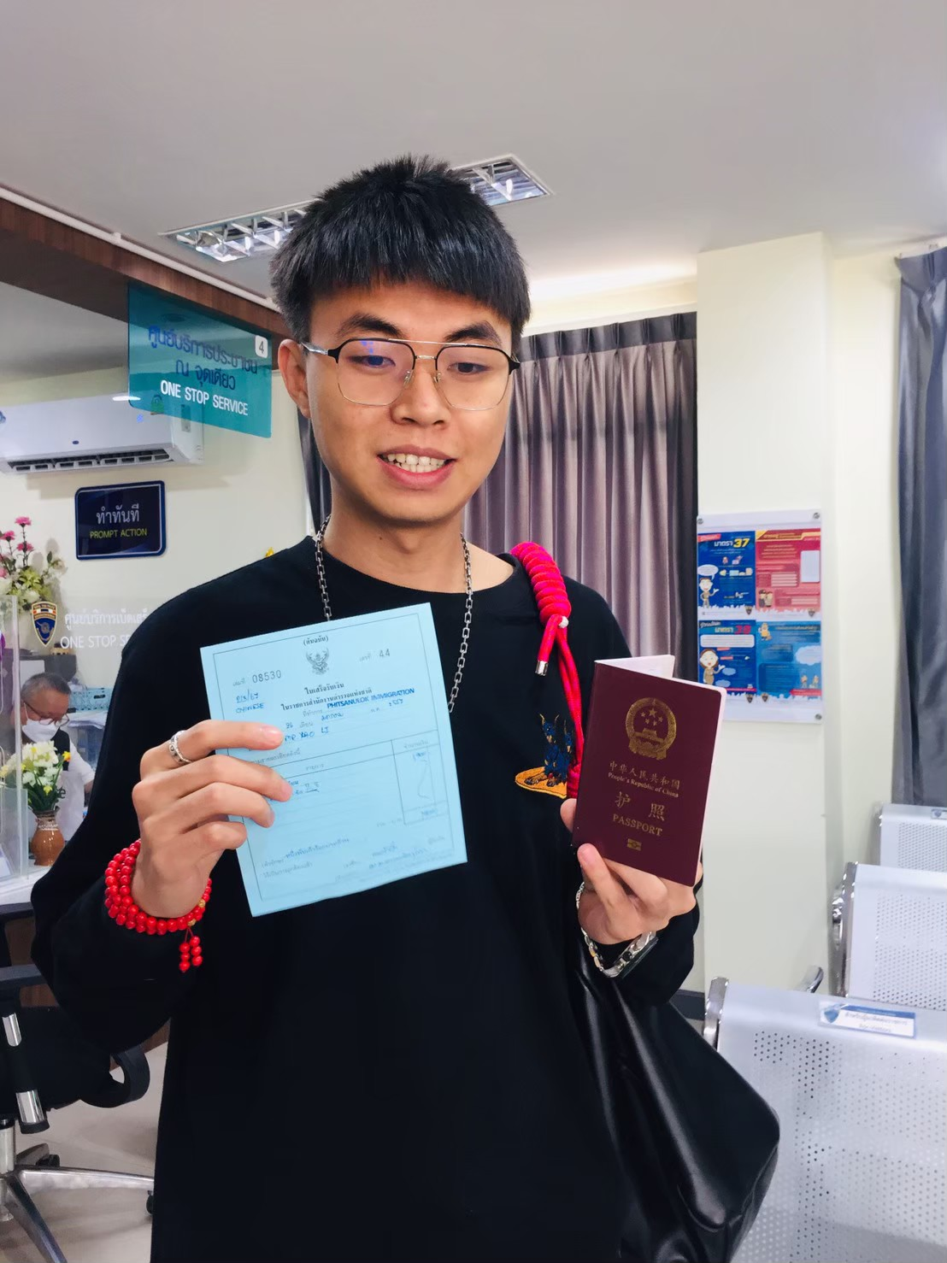
During Study Period – Your Responsibilities在学习期间-你的责任 Immigration Requirements While Studying在学习期间的移民要求
3. Visa Extension: 签证延期（续签）
Apply in person at Phitsanulok Immigration Office.本人亲自前往彭世洛移民局办理
Full-time students will be granted an “ED Plus” visa upon their first visa extension. 全日制学生将在首次签证续签时获得‘’ED Plus‘’资格.
← Failure may result in fines of 500 Baht per day, up to a maximum of 20,000 Baht.失败可能会导致罚款500泰铢每天，最高至20000泰铢。
 Notify DIALD at least 30 days before expiry to issue an official letter.在到期前至少30天通知DIALD，以便发出正式的信函.

Slide 9
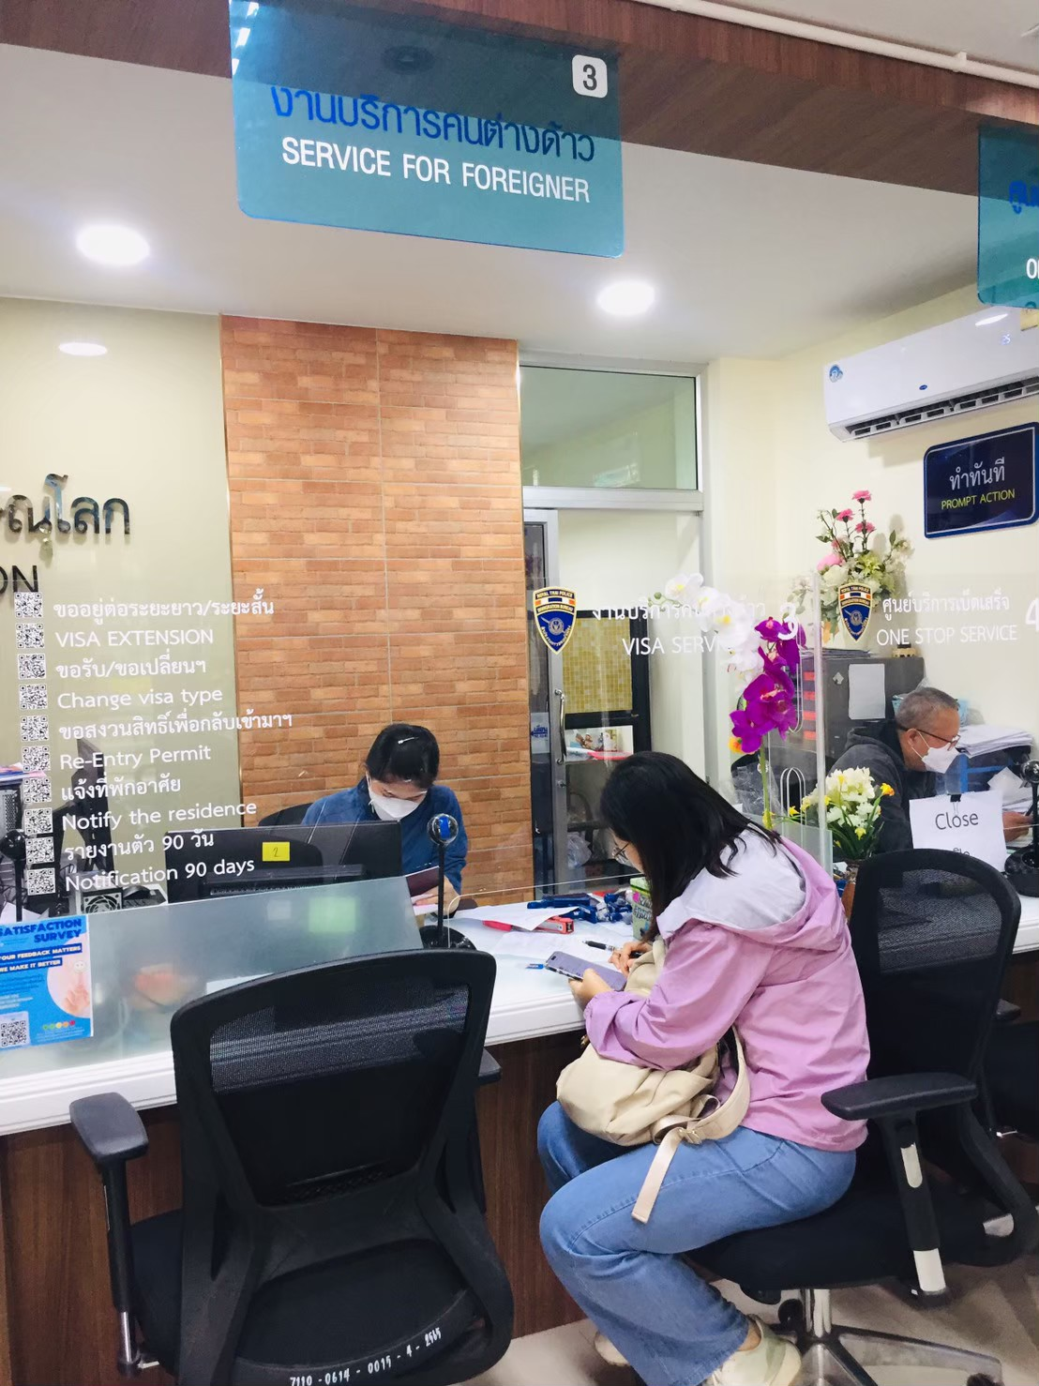
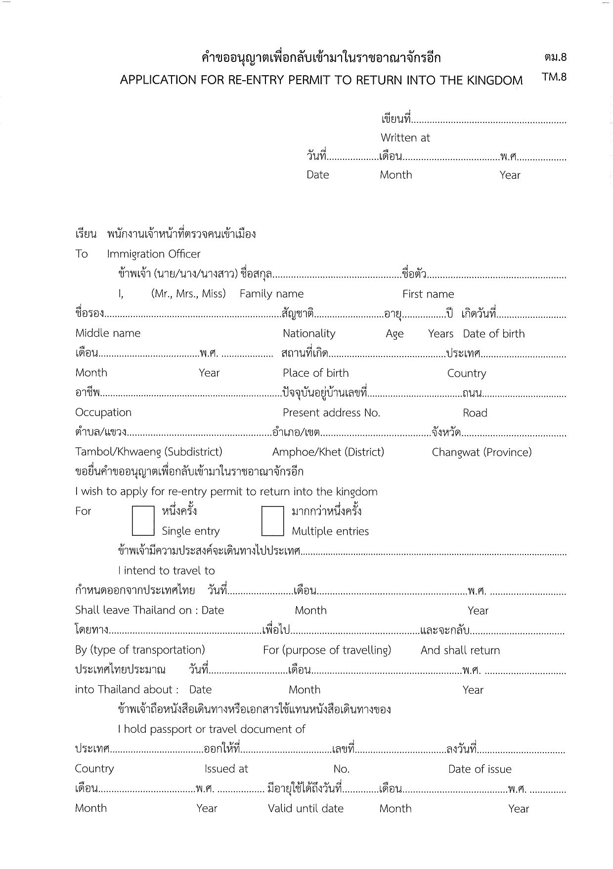
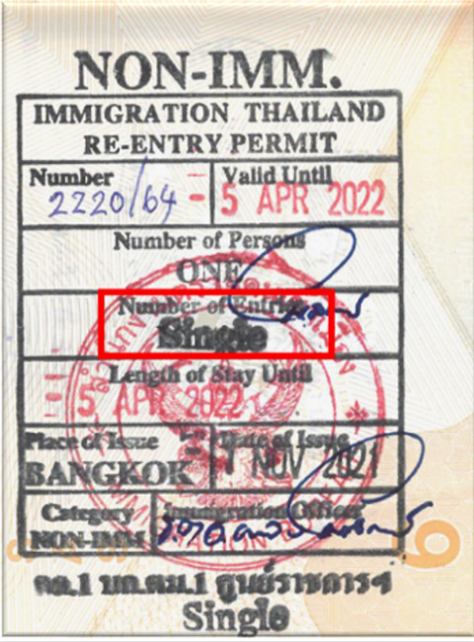
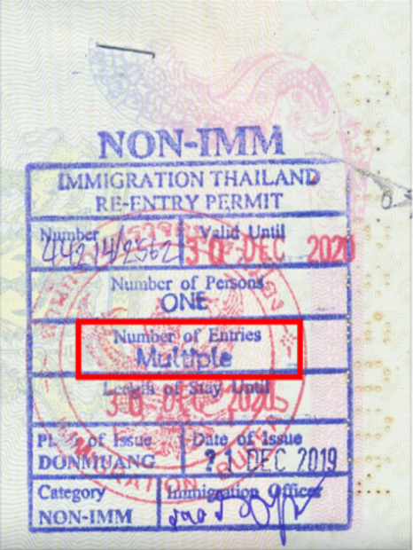
During Study Period – Your Responsibilities 在学习期间-你的责任 Immigration Requirements While Studying 在学习期间的移民要求
4. Re-entry Permit: 重新入境许可
Apply in person if travelling abroad
(except for “ED Plus” visa holders). 如果出国要本人亲自办理（除了持有”ED Plus’’签证）
Form表格
Single Entry单次入境
Multiple Entry多次入境

Slide 10
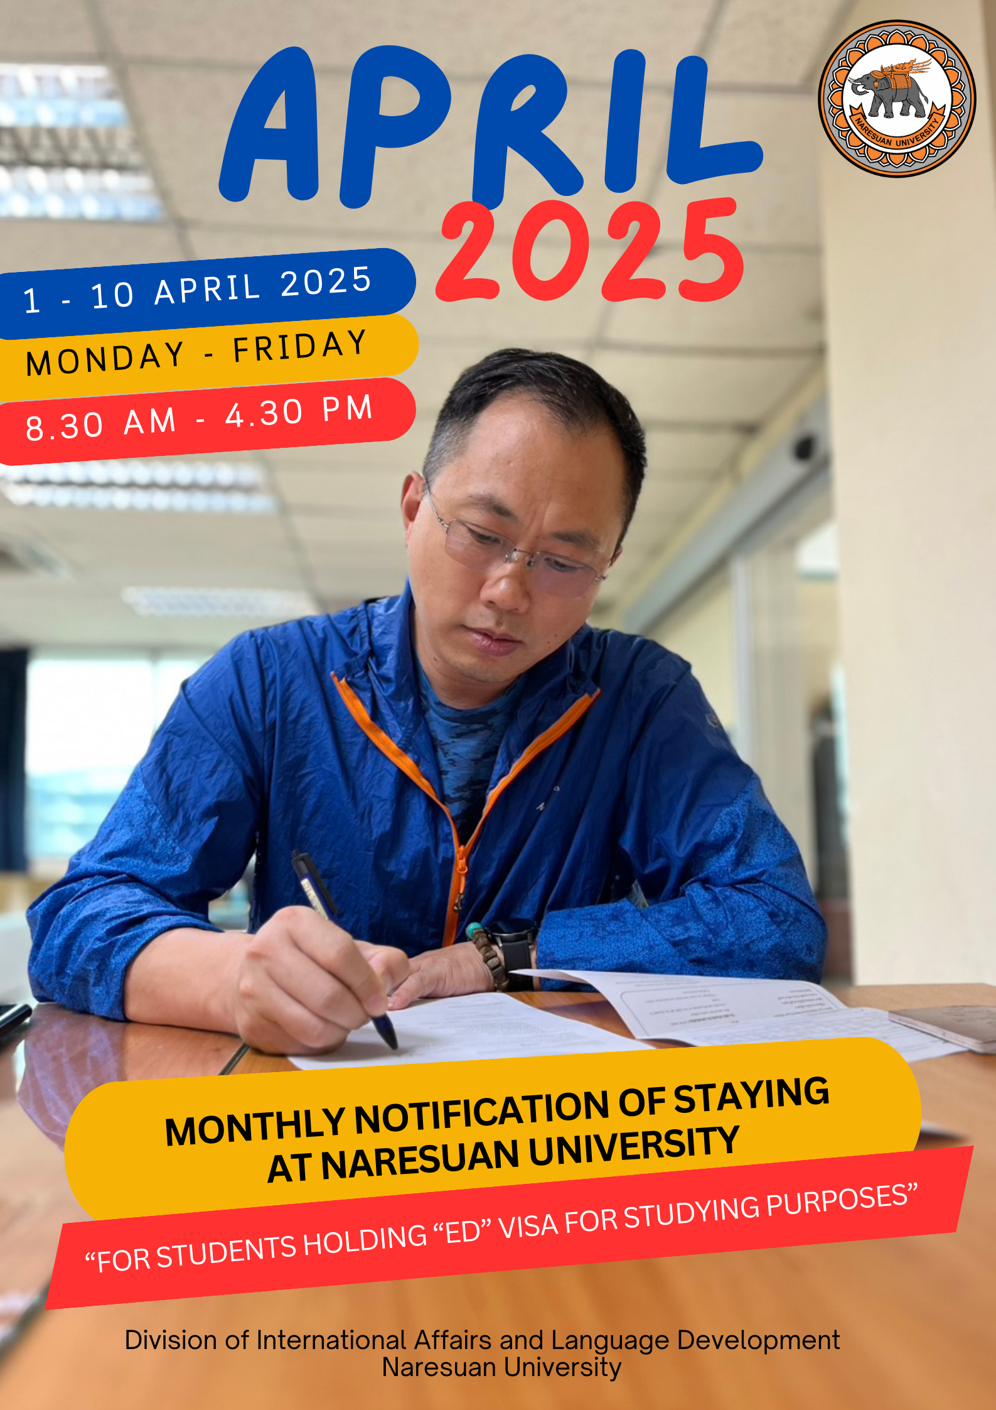
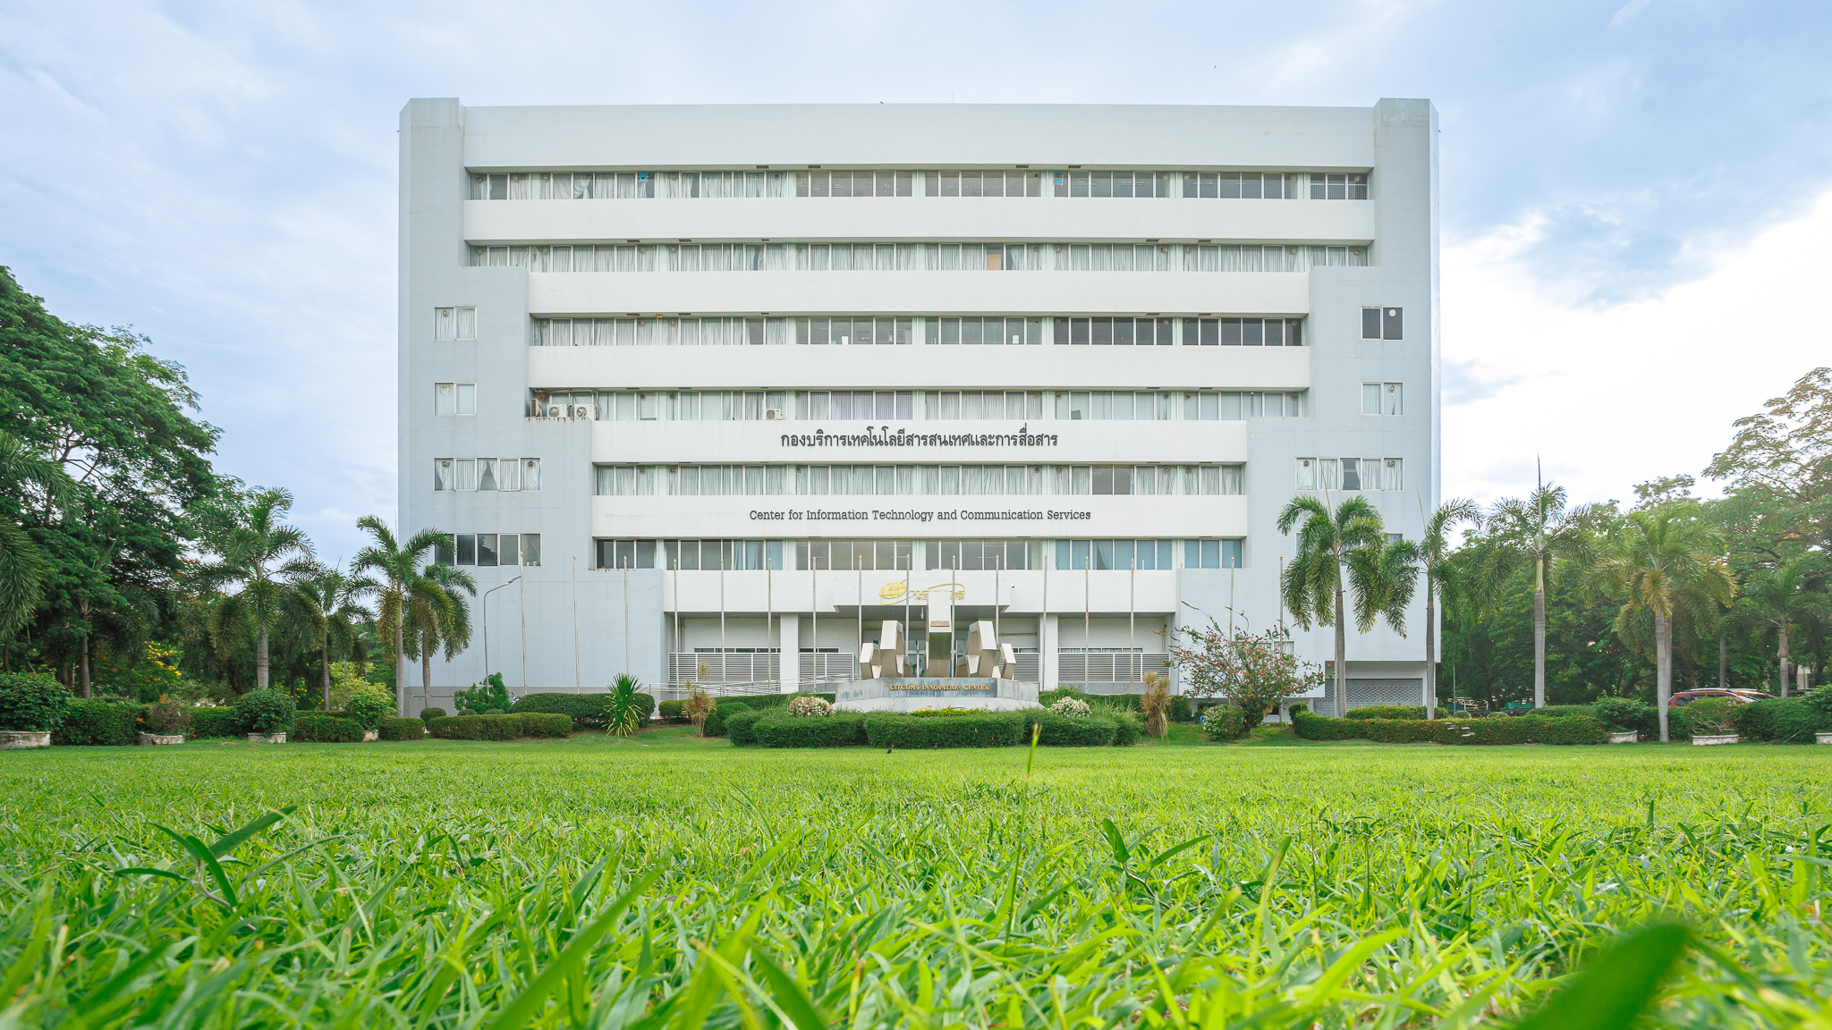
During Study Period – Your Responsibilities 在学习期间-你的责任 NU Requirements While Studying在学习期间NU的要求
5. Report in person at DIALD between the 1st and 10th of each month on working days.在每个月1-10号的工作日到DIALD进行报到
Note: This is separate from the 90-day immigration report. 提示：和到移民局九十天报到分开的
DIALD Office – 5th Floor of CITCOMs Building 国际事务和语言发展中心-CITCOMS楼第五层
Office hour Monday – Friday 08.30 – 16.30 hrs. 办公时间星期一至星期五 8.30-16.30

Slide 11
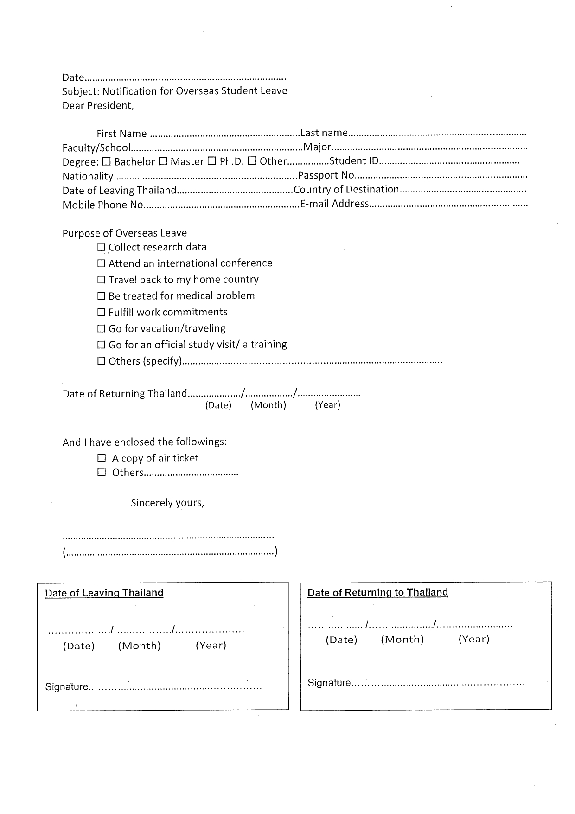
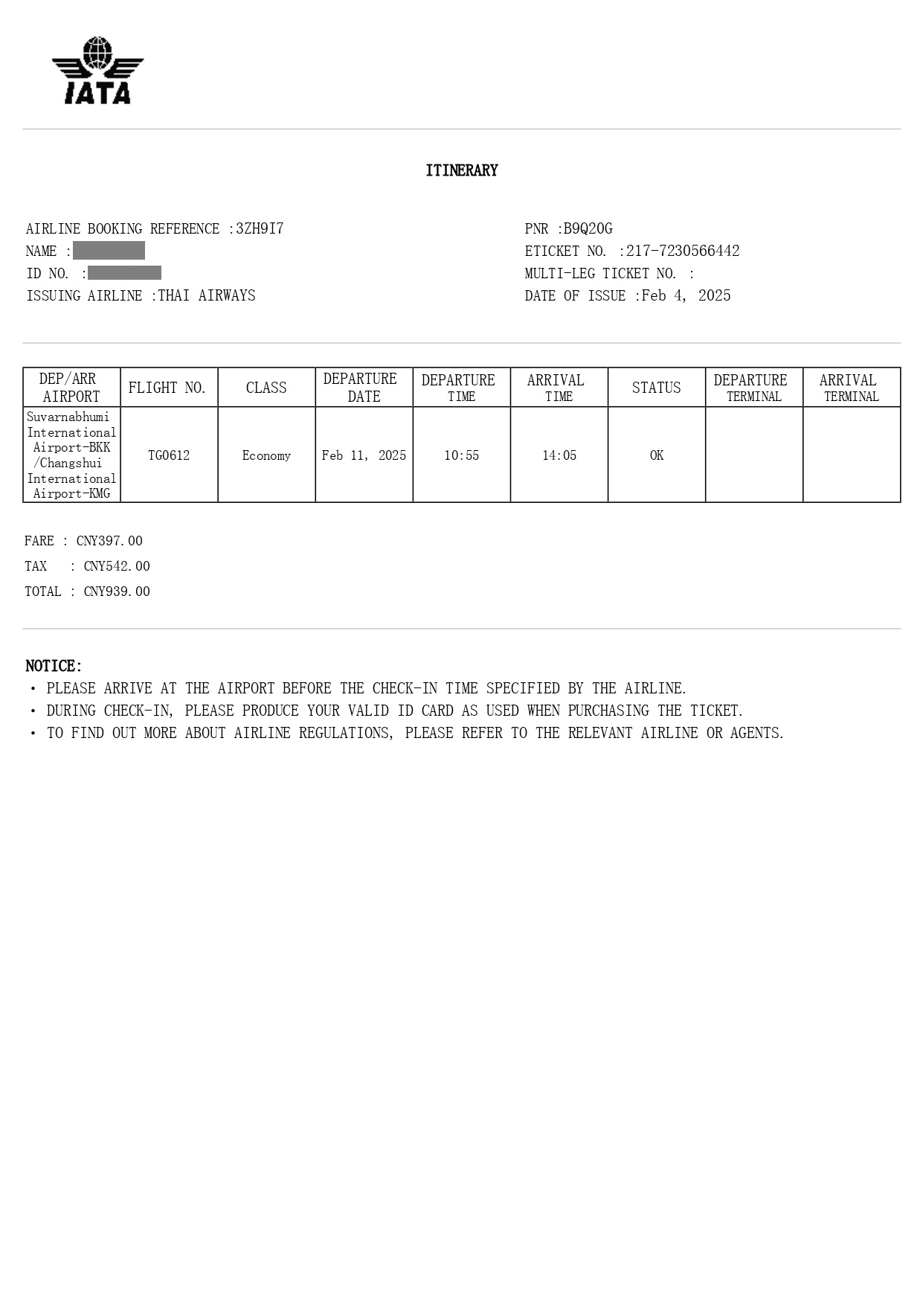
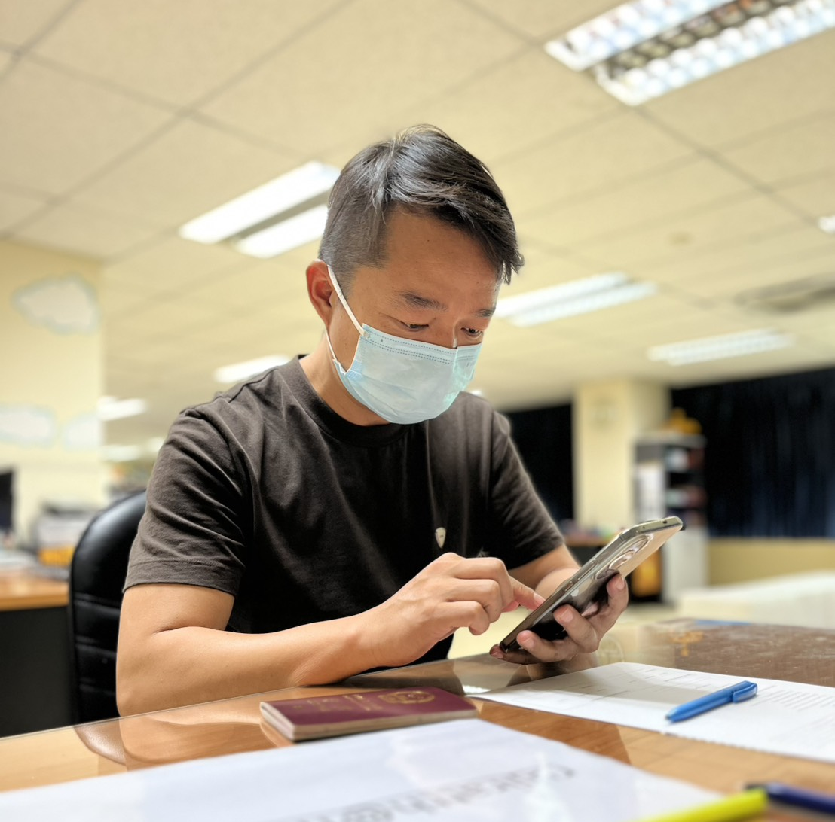
During Study Period – Your Responsibilities在学习期间-你的责任 Immigration Requirements While Studying在学习期间的移民要求
6. Notify DIALD every time you leave and return to Thailand. 通知DIALD每次你离开和重新返回泰国
* Copy of Flight Booking is required.需要提供你的机票复印件
Form 表格
Flight Booking
订购的机票

Slide 12
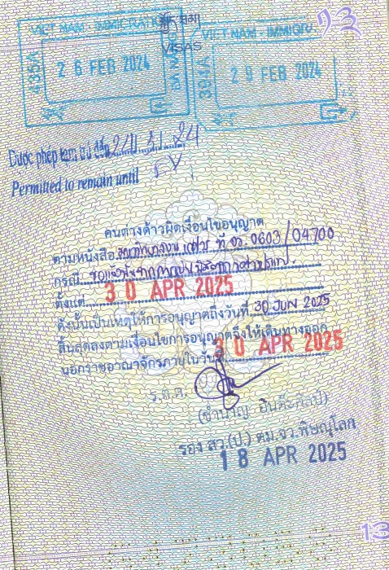
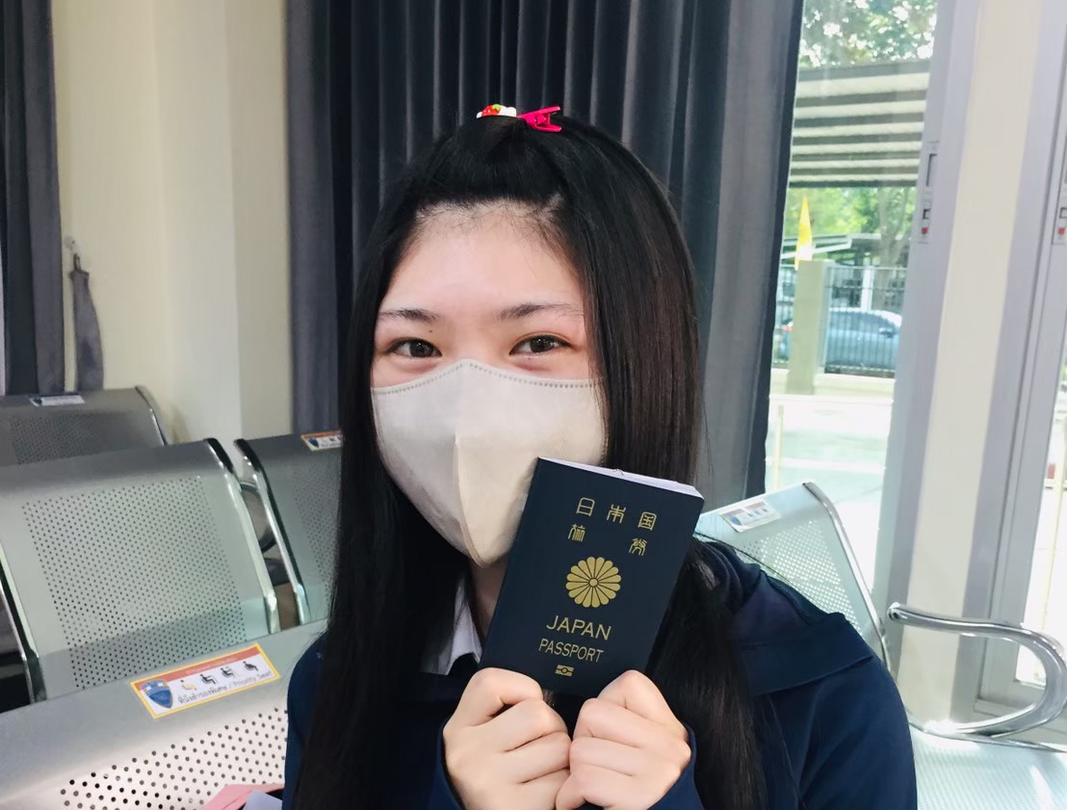
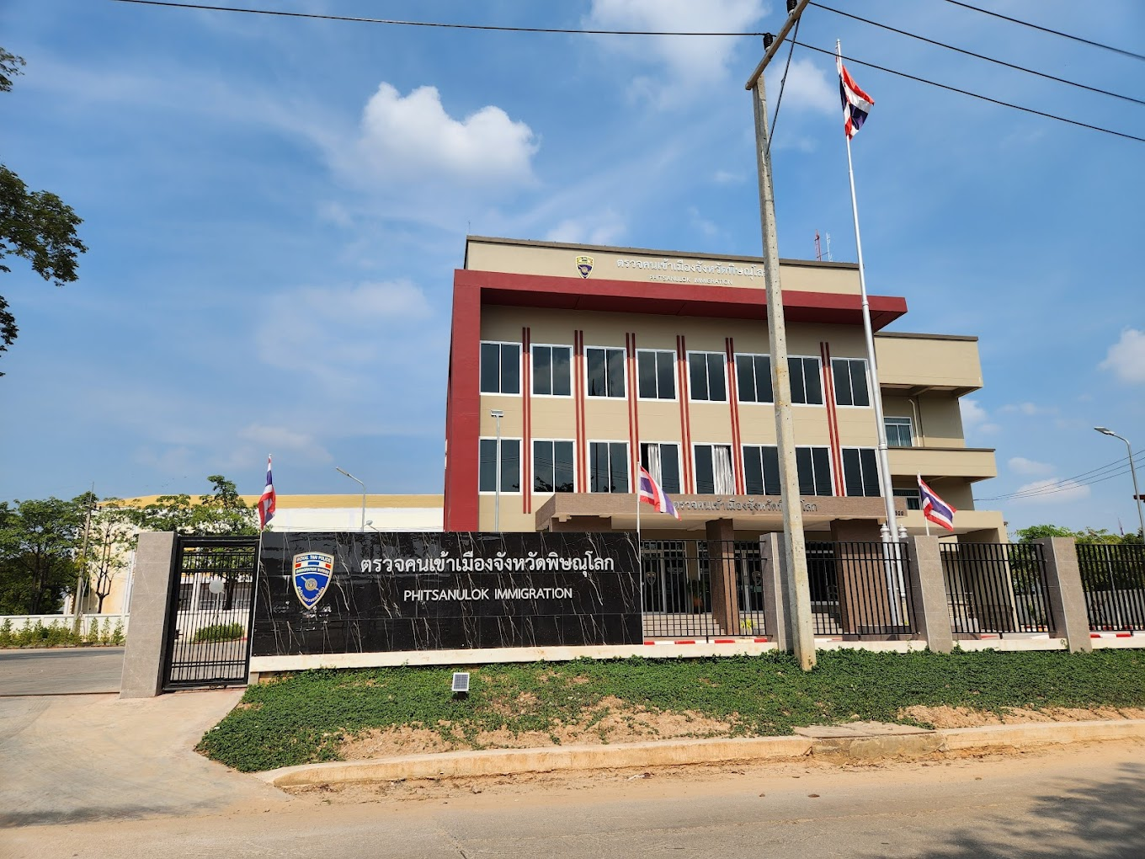
Leaving Thailand - Cancel Visa 离开泰国-取消签证
Cancel your visa properly: 正确取消你的签证
In person at Phitsanulok Immigration Office. 本人亲自到彭世洛移民局办理
 Notify DIALD at least 30 days before your departure. 通知DIALD在你出发前至少30天
Last Date
30 APR 2025

Slide 13






General DOs: What You Should Do 一般要做的:你应该做什么 Follow all university rules遵守所有的大学规则
Dress appropriately.穿着正确.
Be polite and respectful to teachers and staff.
对老师们和工作人员保持礼貌和尊重.
Avoid making noises that disturb others in study areas.在学习的地方避免制造噪音打扰其他人.
Be punctual and attend classes regularly.准时和参加日常的课.

Slide 14
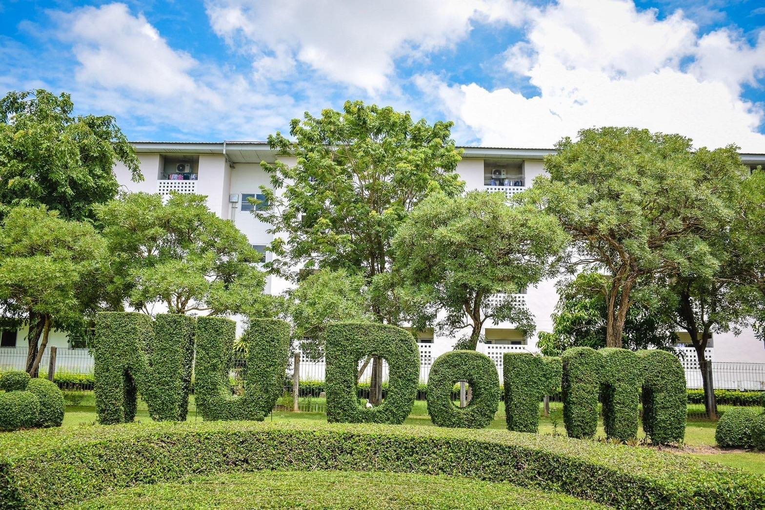







General DOs: What You Should Do 一般要做的:你需要做什么 Follow all university dormitory rules遵守所有的大学宿舍的规则
Do not make loud noises.不要大声吵闹
Keep to the left when driving or riding.驾驶或者骑行的时候保持靠左
Do not pour food waste into the sink.不要把浪费的食物倒在下水道里.
Remove your shoes when there is a sign asking you to.脱鞋当看到标志时
Do not cook inside the dormitory.不要在宿舍里面煮饭
Do not bring outsiders to university dormitory areas without authorization.没有允许不要带外面的人进学校宿舍区域
Carry your student ID or a copy of your passport
at all times.时刻携带你的学生证或者护照复印件

Slide 15






Important DONTs: What to Avoid重要的不能做的事：避免做什么
Do not disrespect the Royal Family (strictly prohibited and illegal).不要不尊重皇室成员（严令禁止的和违法的）
Do not raise your voice or argue in public.在公共场合不要大声喧哗或吵闹.
Do not sit on tables or point your feet at people or sacred objects.不要坐在桌子上或者把脚放在人或者神圣的物件上
Do not use or carry illegal drugs (serious legal consequences).
不要吸食或者携带违法的药物（严重违法）
Do not touch someone’s head – it‘s considered disrespectful.
不要摸某个人的头-这被认为是不尊重的表现

Slide 16

THANK YOU谢谢！

